Slide 1
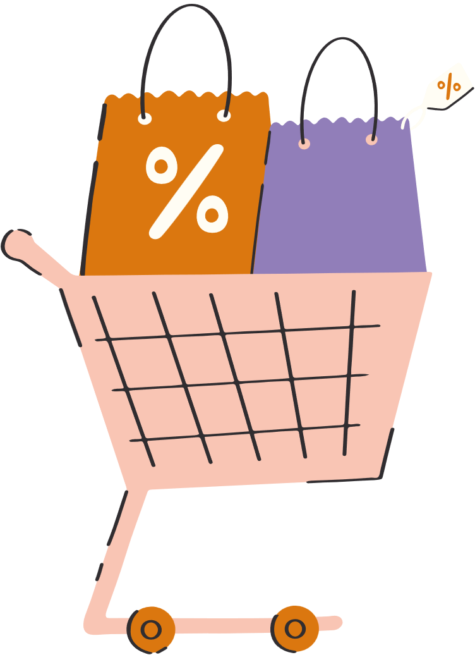

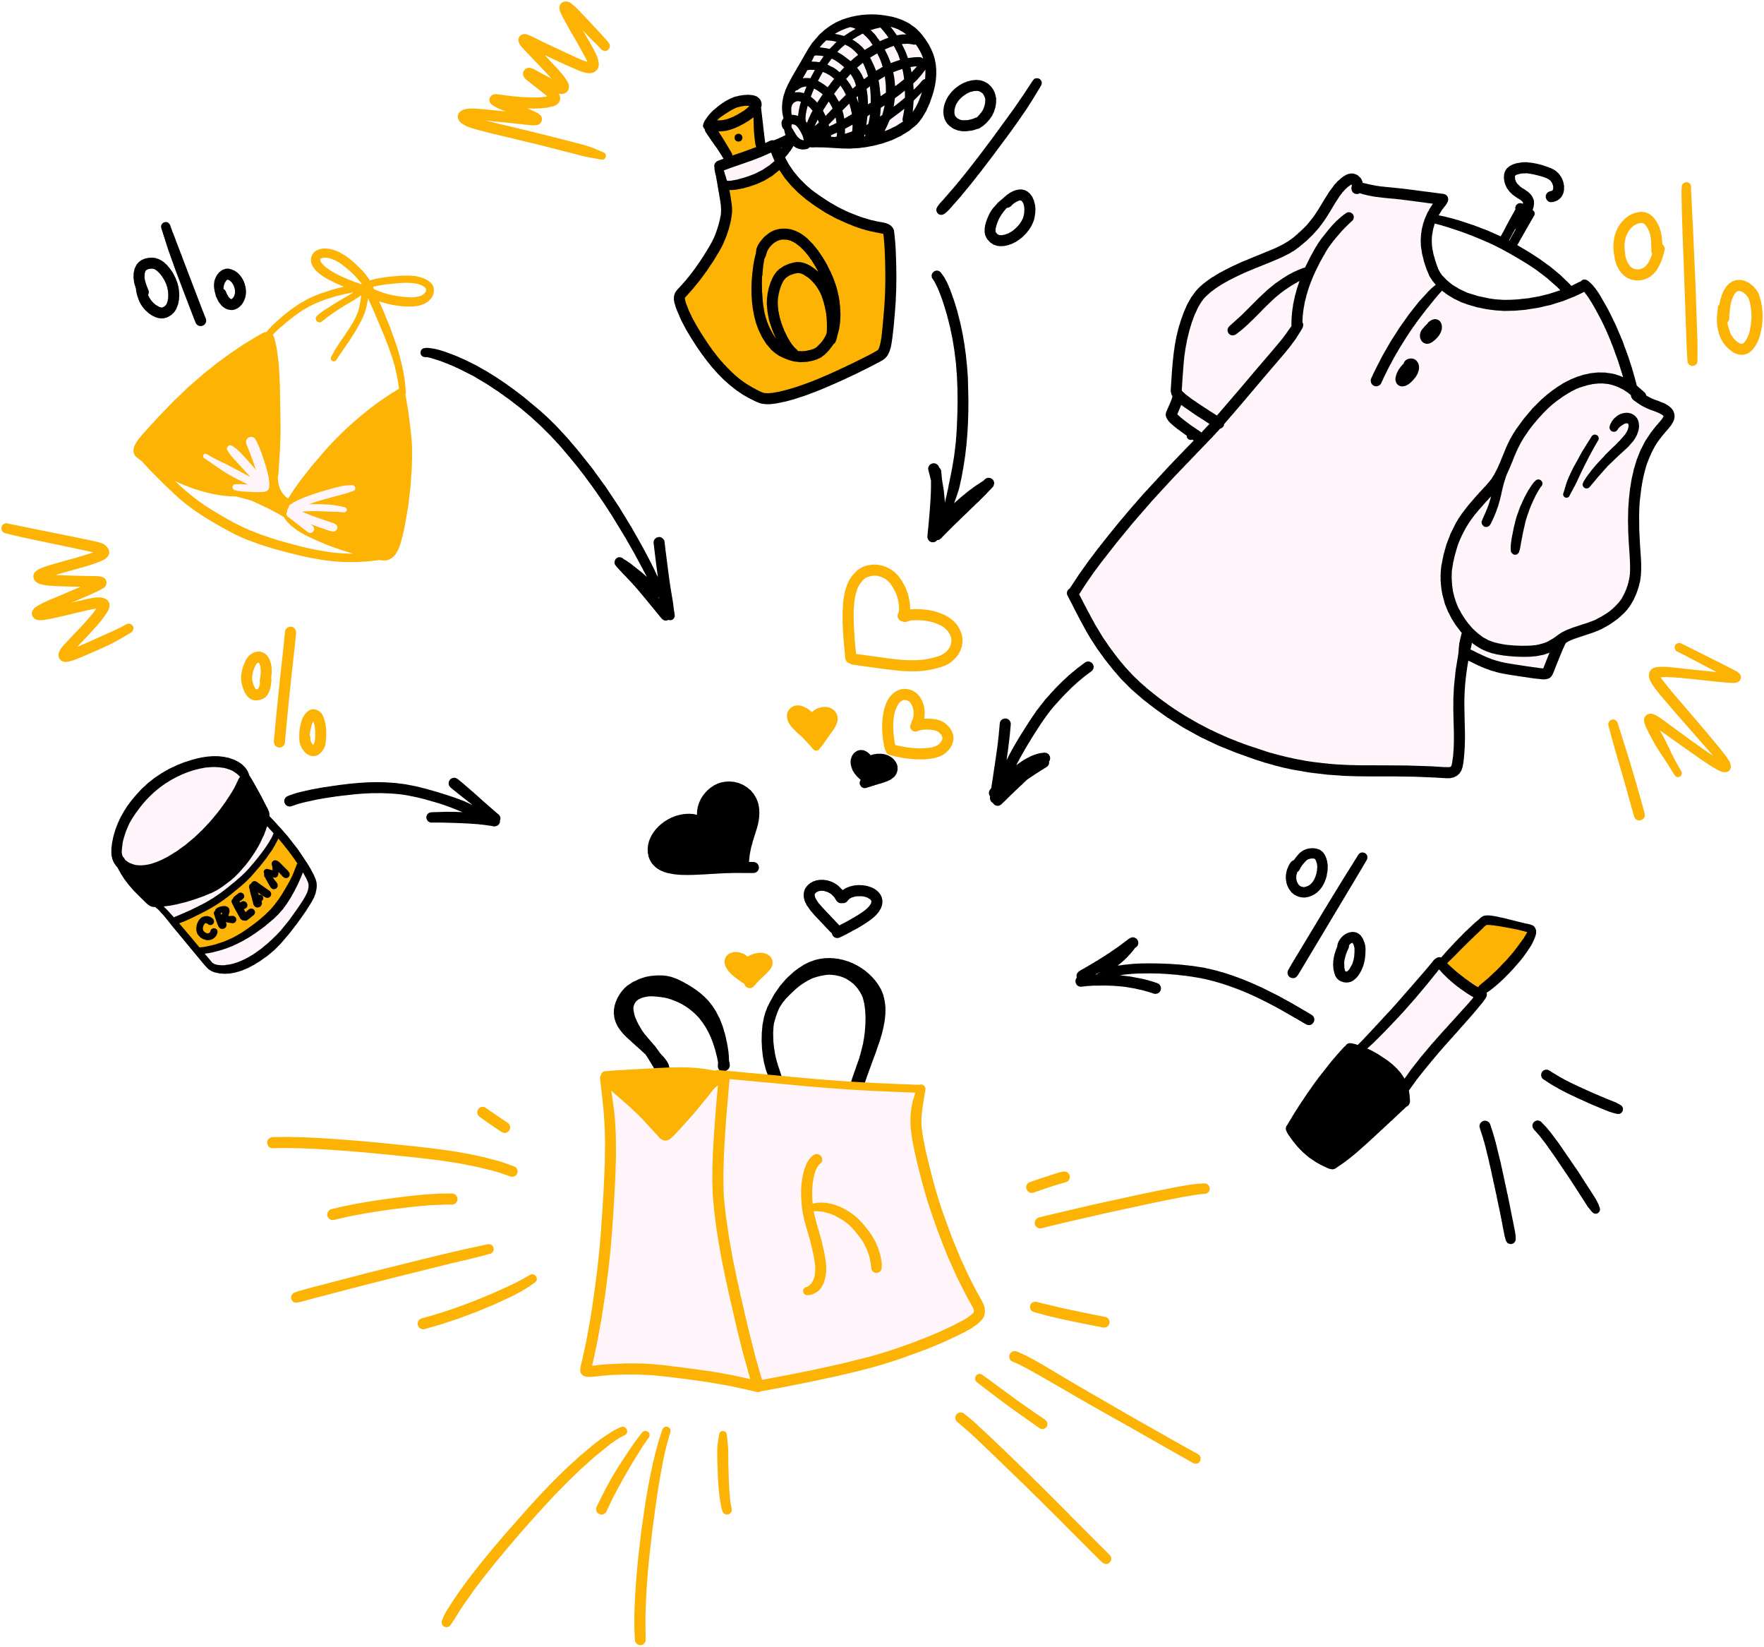
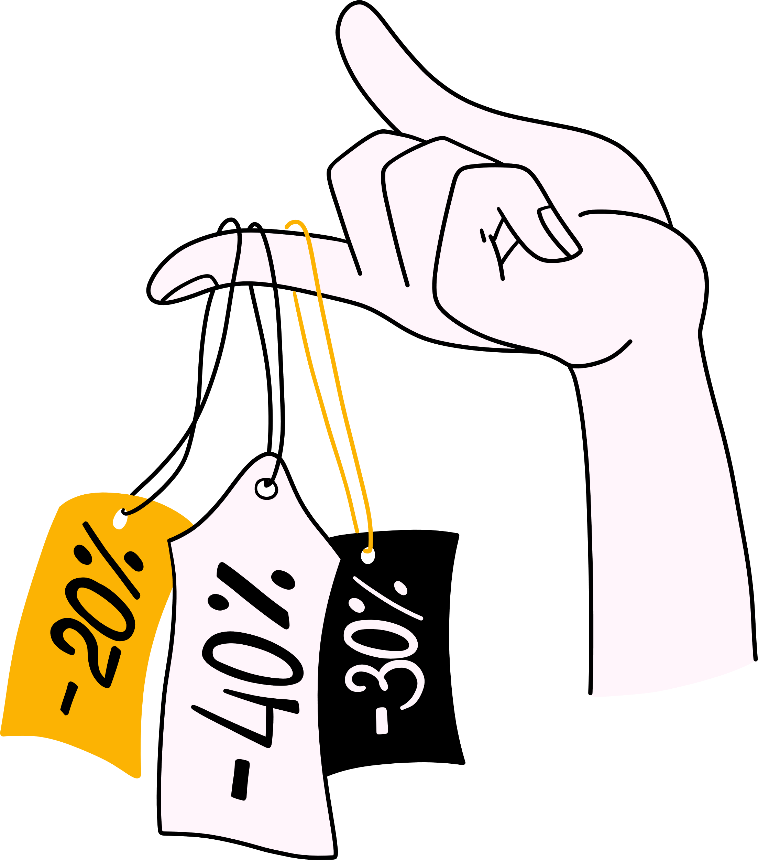







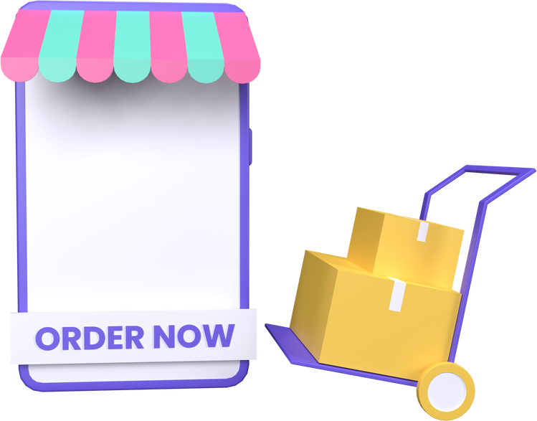
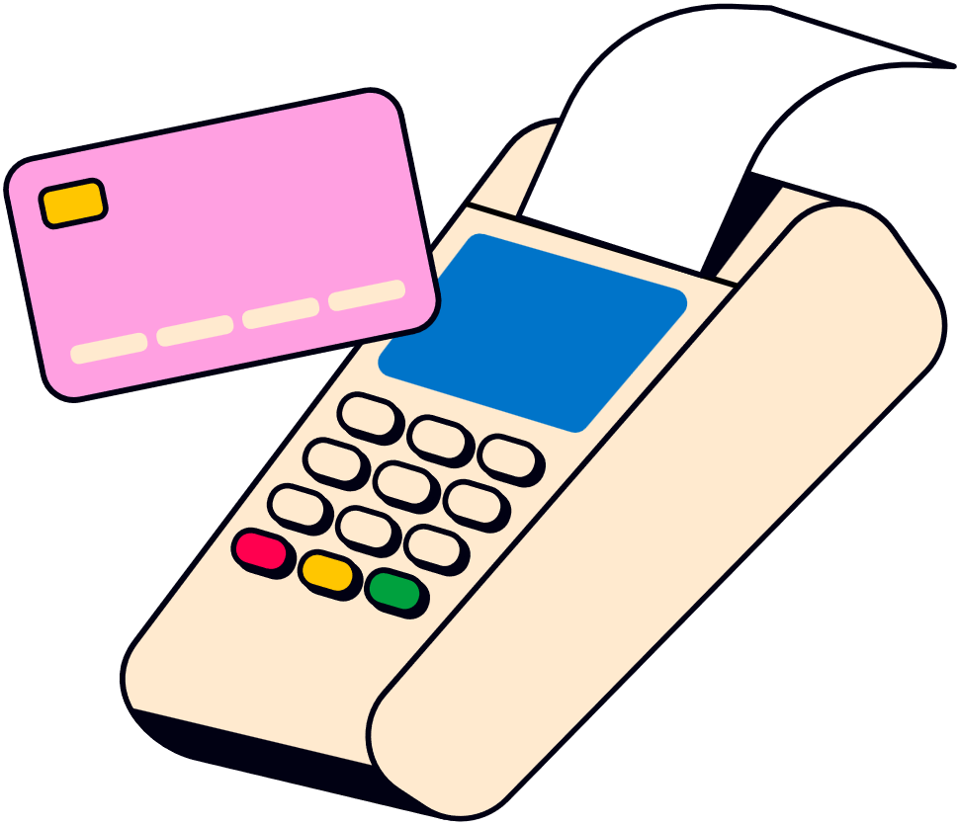

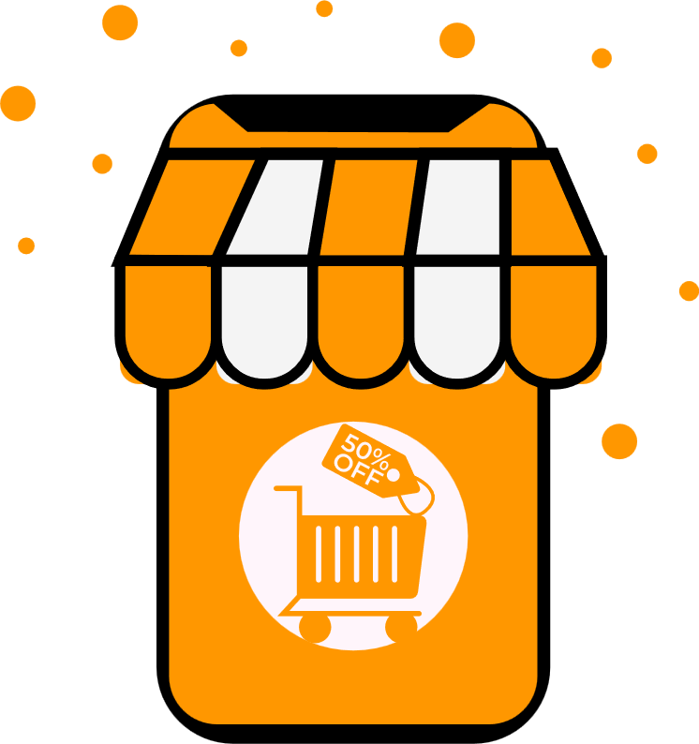

Online Shopping
Application
03 JAN 2026
-Mayukani Tayde
myukanitayde9@gmail.com

Slide 2



OBJECTIVE
The objective of this project is to design and implement a normalized relational database for an online shopping application using SQL. This project focuses on efficient database schema design with proper use of primary and foreign keys to maintain data integrity. It also aims to perform query-based data analysis to evaluate customer behavior, order processing, revenue generation, inventory management, and overall business performance, thereby supporting effective decision-making in an online retail system.

Slide 3



Database Overview
Data refers to raw, unorganized facts and figures, such as numbers, text, images, or symbols, that can be processed and analyzed to extract meaningful information
Data can exist in a raw form (unorganized) or processed form (organized and meaningful).
A database is a structured collection of data designed for efficient storage, retrieval and manipulation.
It serves as a centralized repository, allowing data to be accessed, managed, and updated by multiple users or applications

Slide 4
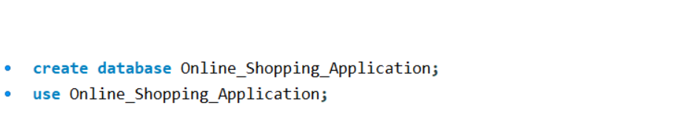
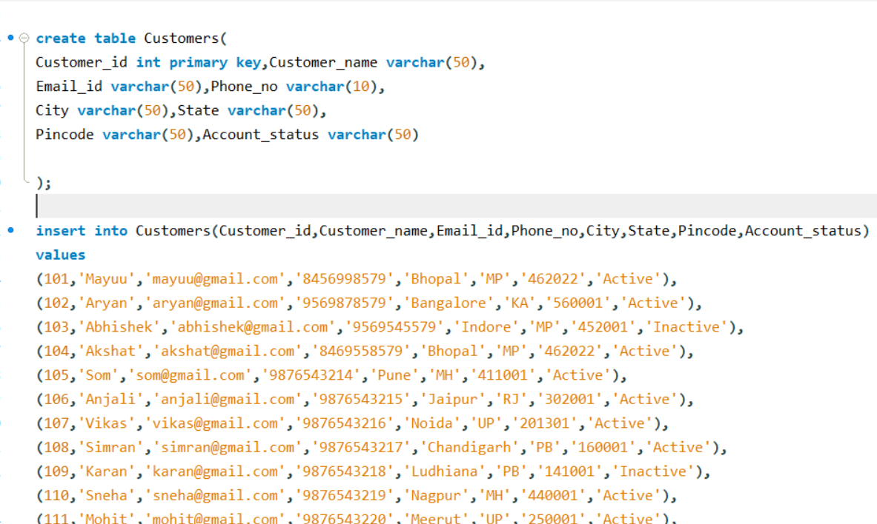
DATABASE CREATION
The database was created using SQL and structured tables were designed using appropriate data types and constraints.
TABLES CREATION
The Structured tables were designed using appropriate data types and constraints.

Slide 5





Smart Idea
TABLES
IN DATABASE
Customers Table –
Stores customer details such as name, email, phone number, city, state, pincode, and account status.
Categories Table –
Contains product category information like category name and active status.
Products Table –
Stores product details including product name, category, price, stock quantity, brand, and availability status.
Orders Table –
Maintains order-level information such as customer ID, order date, total amount, order status, and payment status.
Order_Items Table –
Stores product-wise order details including order ID, product ID, quantity, and price for each order.
Reviews Table –
Contains customer reviews and ratings for products to analyze product quality and customer satisfaction.
Shipping Table –
Tracks shipping and delivery details such as shipping address, shipping date, delivery date, and shipping status.

Slide 6

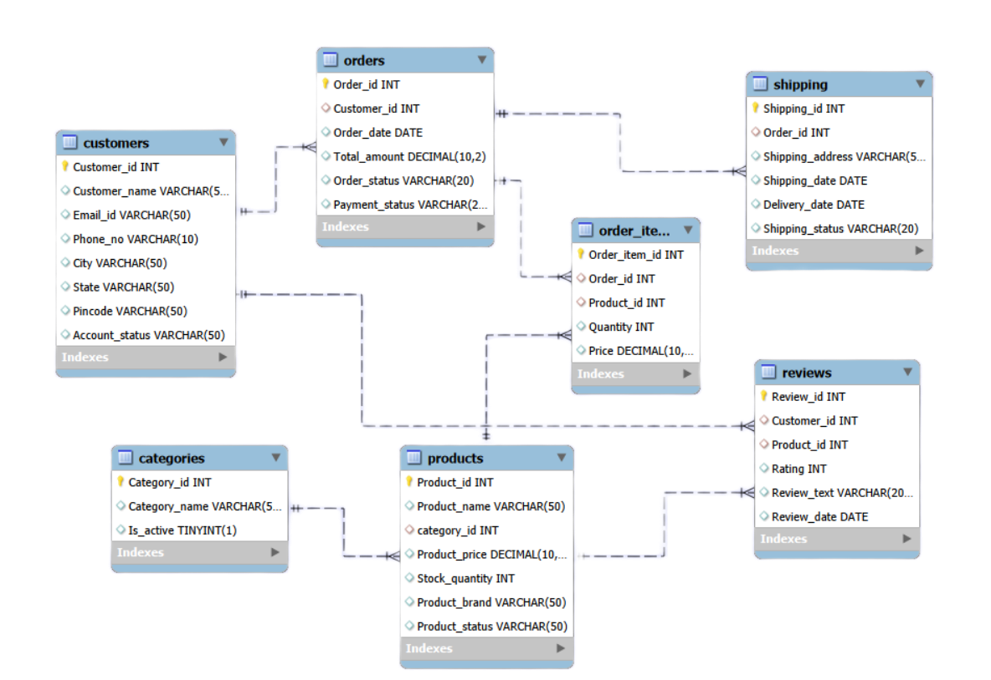
ER - DIAGRAM
This ER diagram shows the relationship between customers, orders, products, and other entities using primary and foreign keys.
It ensures proper data integrity and avoids data redundancy.

Slide 7
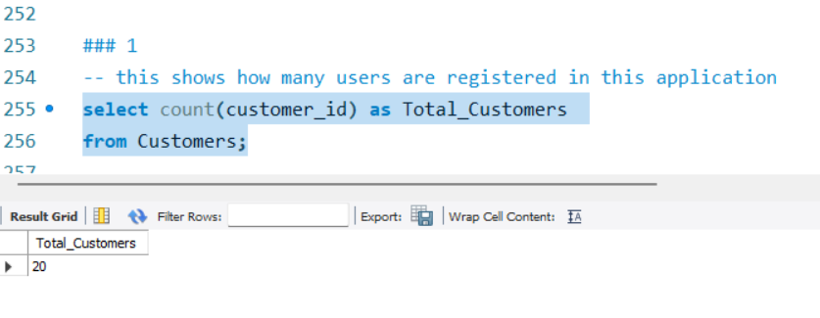
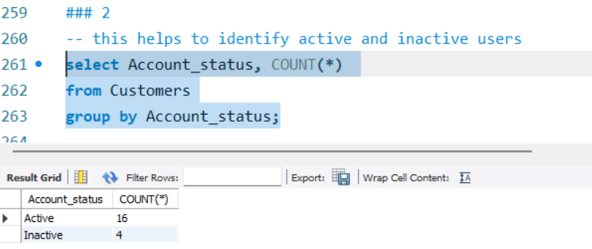
1️⃣ TOTAL REGISTERED CUSTOMERS
Shows how many users are registered in the application.
2️⃣ ACTIVE VS INACTIVE CUSTOMERS
This insight helps identify how many customers are active and inactive.

Slide 8
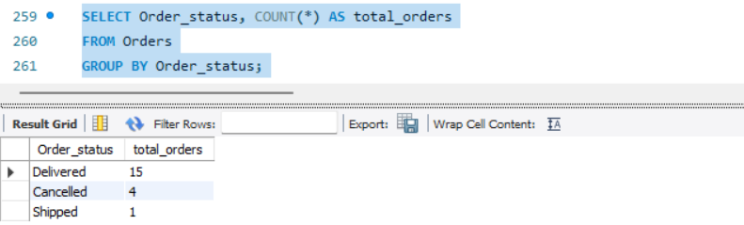
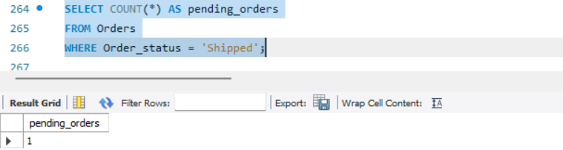
3️⃣ ORDER STATUS BREAKDOWN
This insight shows the distribution of orders by status such as Delivered, Cancelled, and Shipped.
4️⃣ Pending Orders
This insight shows the number of orders that are still pending or not delivered.

Slide 9
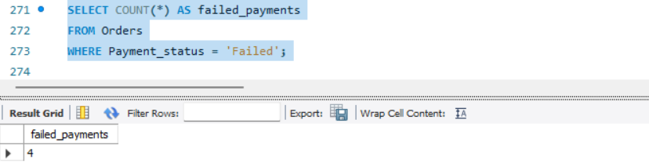
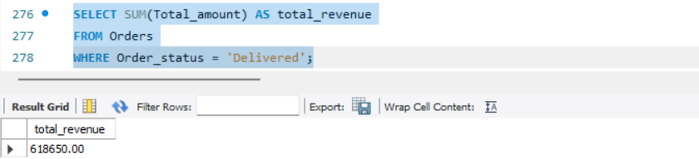
5️⃣ FAILED PAYMENTS ANALYSIS
This insight identifies how many orders failed due to payment issues.
6️⃣ TOTAL REVENUE FROM DELIVERED ORDERS
This insight shows the total revenue generated from successfully delivered orders.

Slide 10
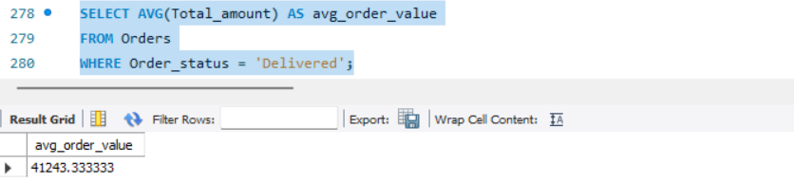
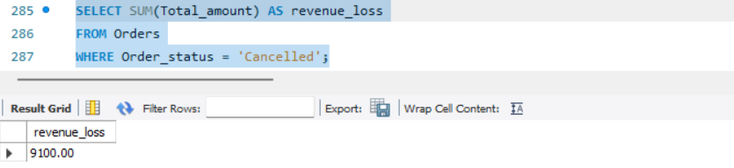
7️⃣ AVERAGE ORDER VALUE
This insight calculates the average amount spent per delivered order.
8️⃣ REVENUE LOSS DUE TO CANCELLED ORDERS
This insight shows the total revenue lost because of cancelled orders.

Slide 11
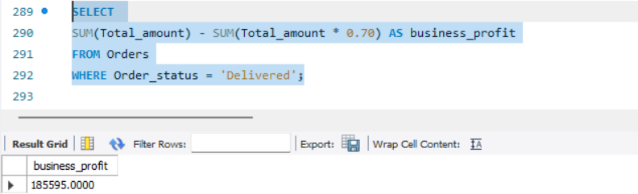
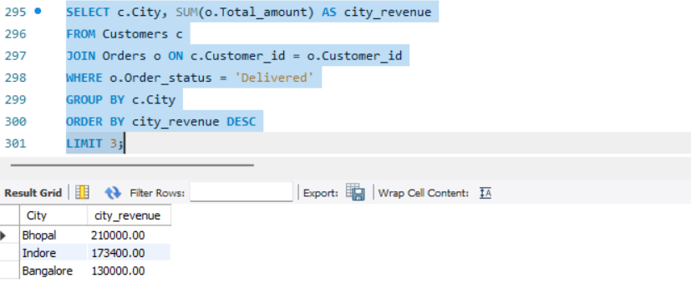
9️⃣ ESTIMATED BUSINESS PROFIT
This insight estimates business profit based on delivered orders using a cost assumption.
🔟 TOP 3 CITIES HIGHEST BY REVENUE
This insight identifies the top three cities generating the highest revenue.

Slide 12
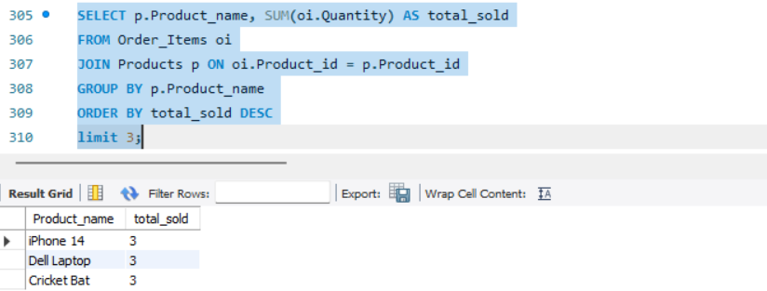
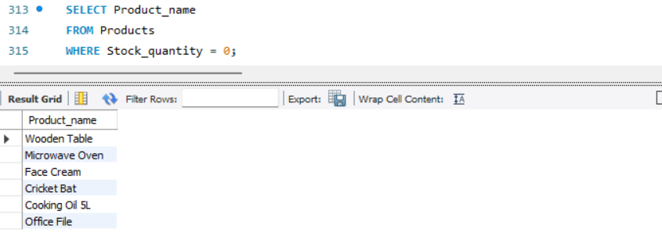
1️⃣1️⃣ MOST SELLING PRODUCTS (TOP 3)
This insight shows the top-selling products based on quantity sold.
1️⃣2️⃣ OUT-OF-STOCK PRODUCTS
This insight identifies products that are currently out of stock.

Slide 13
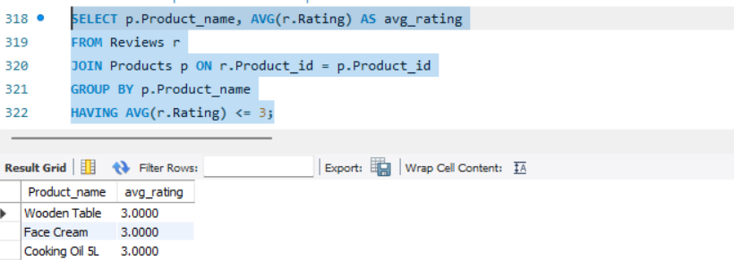
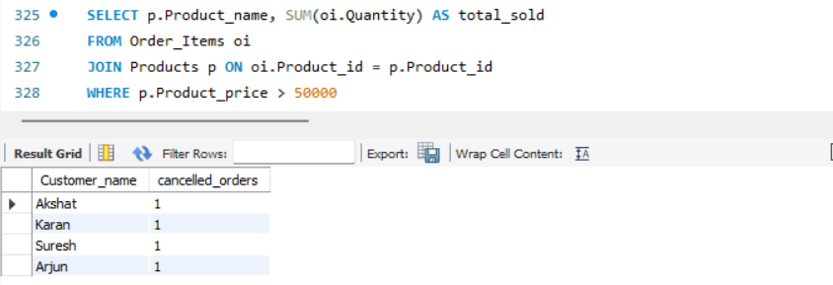
1️⃣3️⃣ LOW RATED PRODUCTS
This insight highlights products with low average ratings that need improvement.
1️⃣4️⃣ HIGH-PRICED PRODUCTS SOLD (> ₹50,000)
This insight shows high-priced products that have been successfully sold.

Slide 14
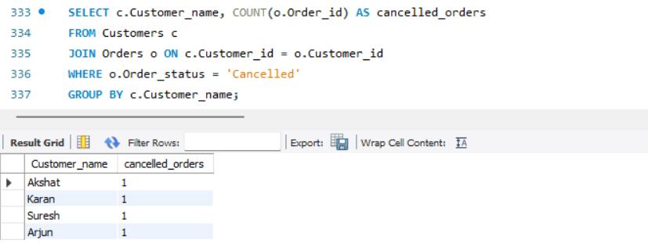
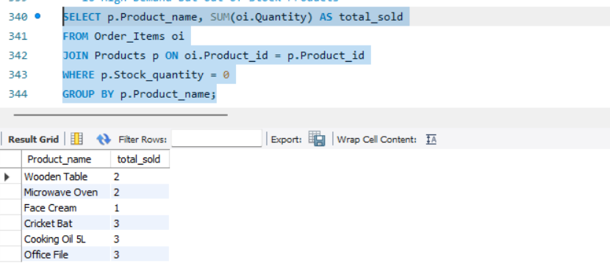
1️⃣5️⃣ CUSTOMERS WITH CANCELLED ORDERS
This insight identifies customers who have cancelled one or more orders.
1️⃣6️⃣ HIGH DEMAND BUT OUT-OF-STOCK PRODUCTS
This insight highlights products with high demand but zero stock availability.

Slide 15


